Slide 1


I-COW-CARE
COW MONITORING DEVICE
HADJ KHELIL EDRISS
OUESLATI NIAM
KAROUI MAJD
KHECHINE ELYES
2022/2023

Slide 2






MEET THE TEAM
IMENE HARBAOUI
RABAA YOUSSEF
HADJ KHELIL EDRISS
OUESLATI NIAM
KAROUI MAJD
KHECHINE ELYES
1 / 15

Slide 3
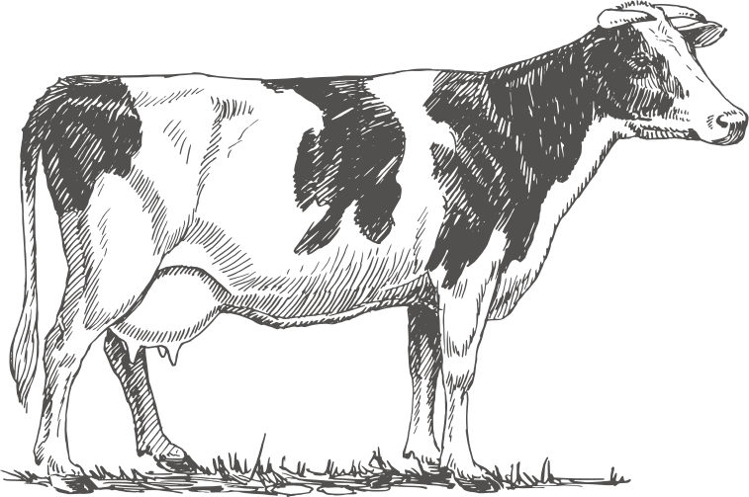
TABLE OF CONTENTS
Project Context
Problem Statement
Our Solution Overview
Hardware and Software Choices
Solution Use Case (Flow Diagram)
Test and Validation
Final Implementation
Results
Conclusion
03-04
05
06
07-08
09
10
11-12
13
14
E
H
L
O
WELCOME TO OUR PRESENTATION
WELCOME TO OUR PRESENTATION
L
2 / 15

Slide 4
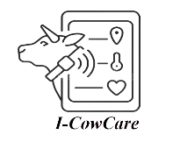
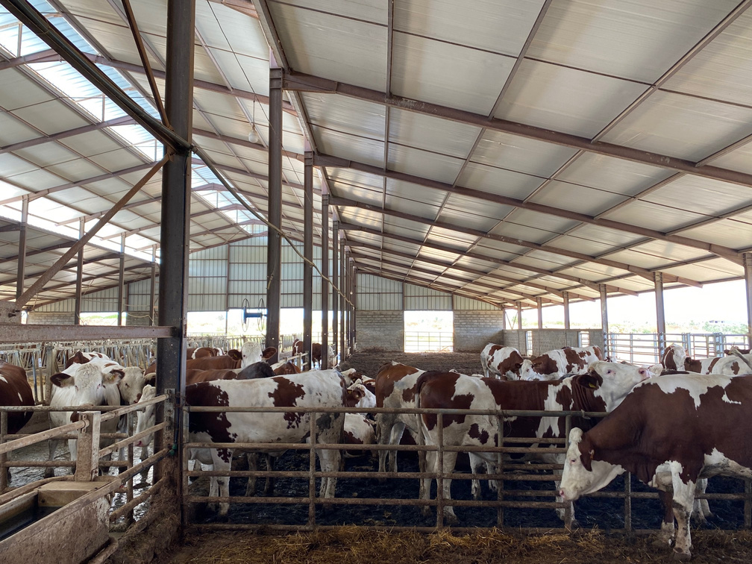
PROJECT CONTEXT
WHAT IS ESTRUS AND ESTRUS DETECTION?
The Estrus ( commonly known as Heat ) comes with a multitude of behavioural and physiological changes notably:
A sudden increase in body temperature.
Lack of interest for food.
Mounting acceptance.
Stress and restlessness.
3 / 15

Slide 5
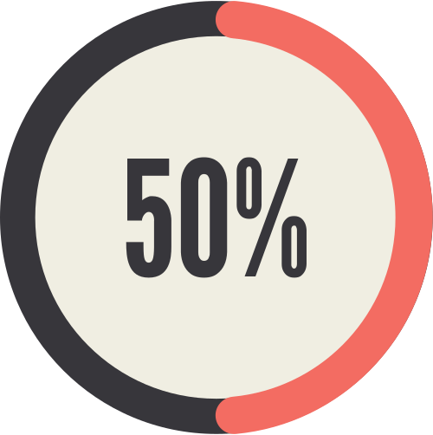
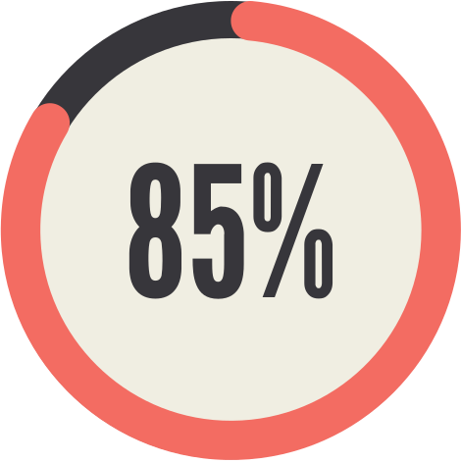
ESTRUS DETECTION SUCCESS RATE
Traditional Observation-Based Detection
Cow monitoring devices Detection rate
4 / 15

Slide 6
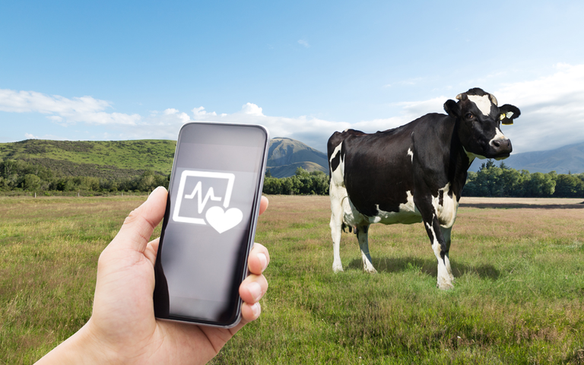
PROBLEM STATEMENT
Cattle monitoring systems are needed to collect data 24/7 and provide valuable information to manage the herd effectively.
By using IoT and Machine Learning techniques, we can detect significant details and improve cow productivity.
5 / 15

Slide 7

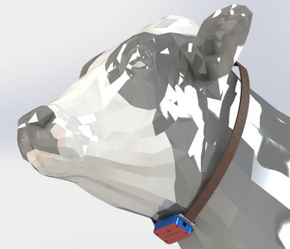
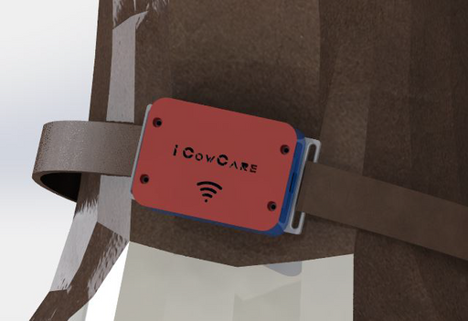
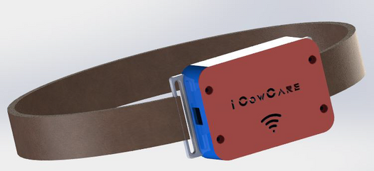
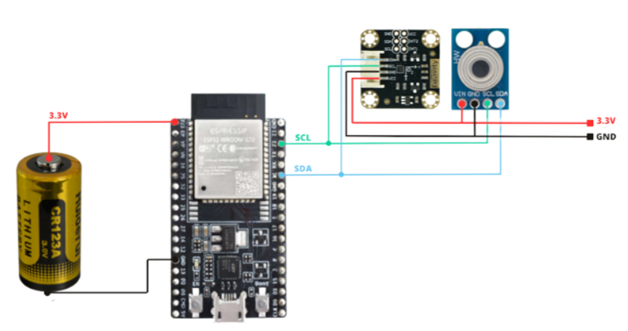
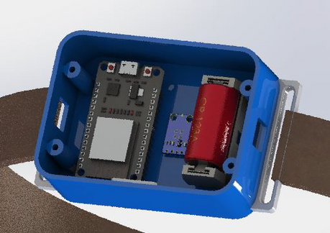
SOLUTION OVERVIEW
KEY FEATURES AND INSIGHTS
Our collar is equipped with temperature and movement sensors, allowing it to constantly gather real-time data. It is also equipped with a battery that assures long-lasting life.
6 / 15

Slide 8
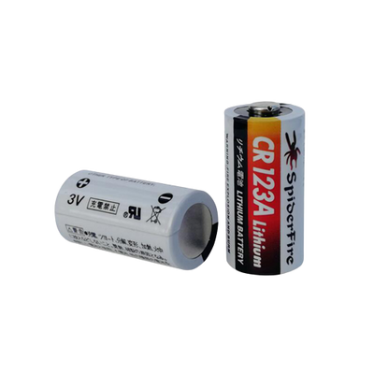
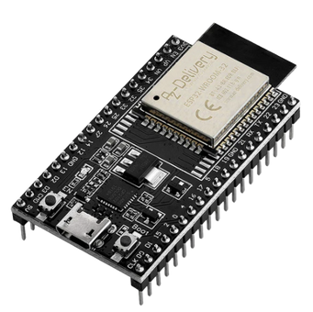
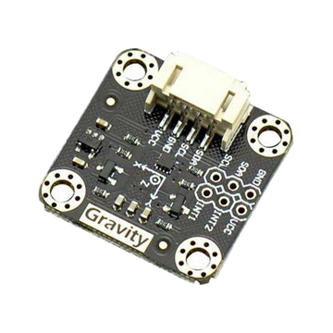
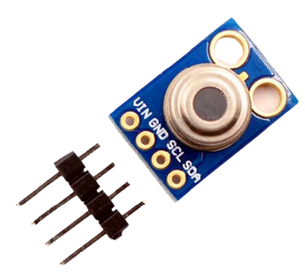
HARDWARE CHOICES
ESP32 DEVKITC V4
GY-906 MLX90614
DFRobot Gravity LIS2DH
CR123A 3V 1300MA
7 / 15

Slide 9




SOFTWARE CHOICES
ARDUINO IDE
NODE-RED
MOSQUITTO MQTT
FIREBASE
8 / 15

Slide 10
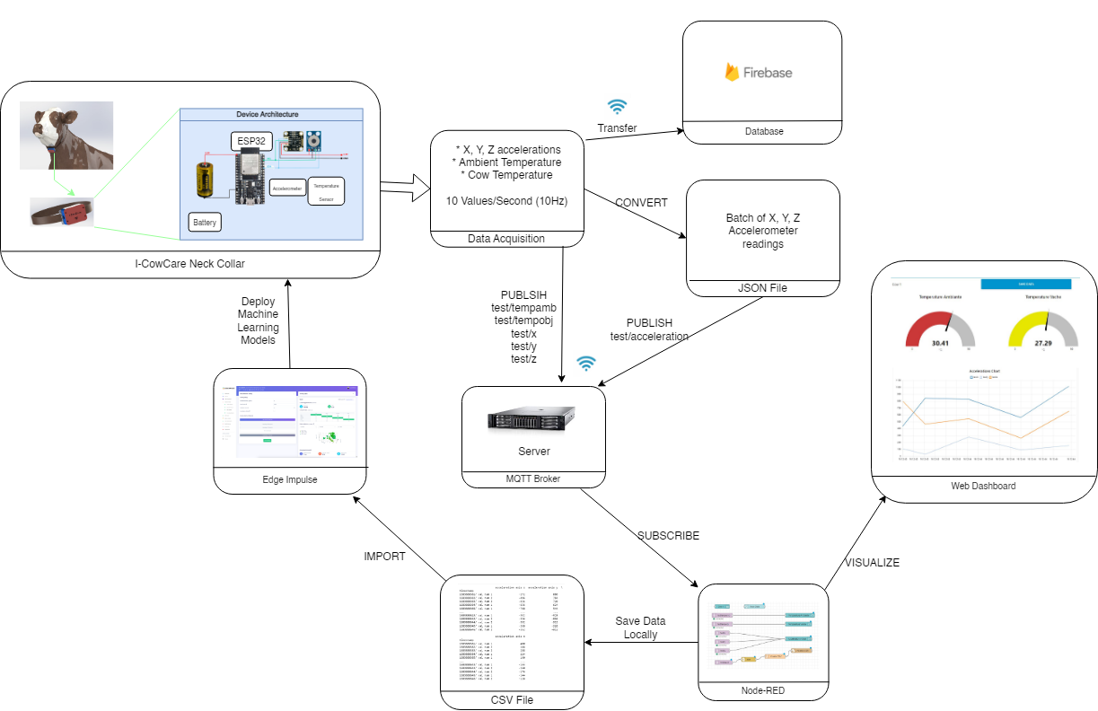
THE SOLUTION USE CASE: FLOW DIAGRAM
9 / 15

Slide 11
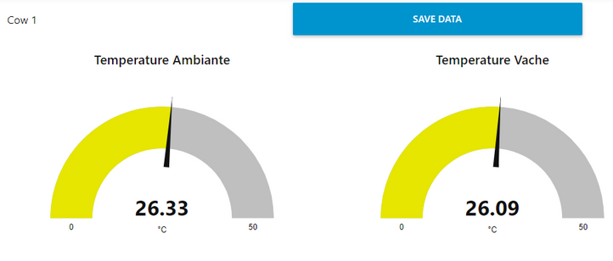
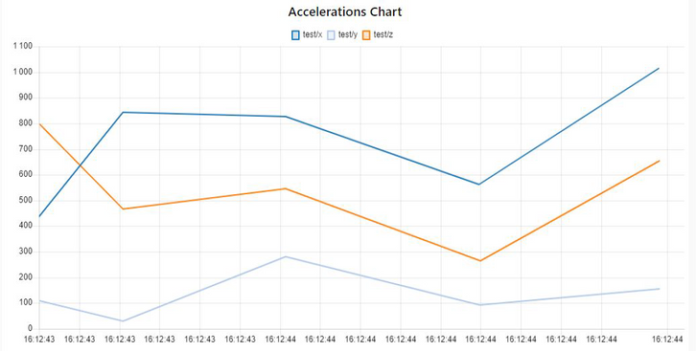
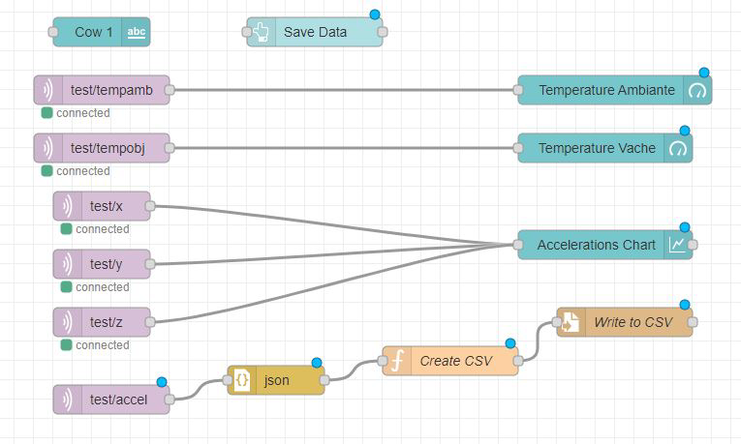
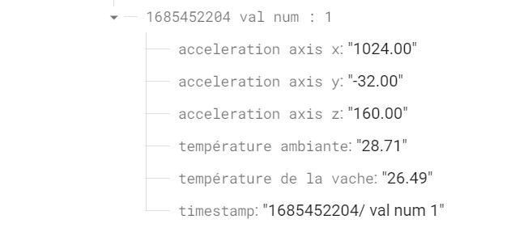
TEST AND VALIDATION
Node-Red Dashboard
We utilized our MQTT subscription to receive data for various topics, including ambient temperature, object temperature, and acceleration values in the X, Y, and Z axes
Firebase
The data collected from the accelerometer and the temperature sensor is transmitted to the Firebase in real time.
10 / 15

Slide 12
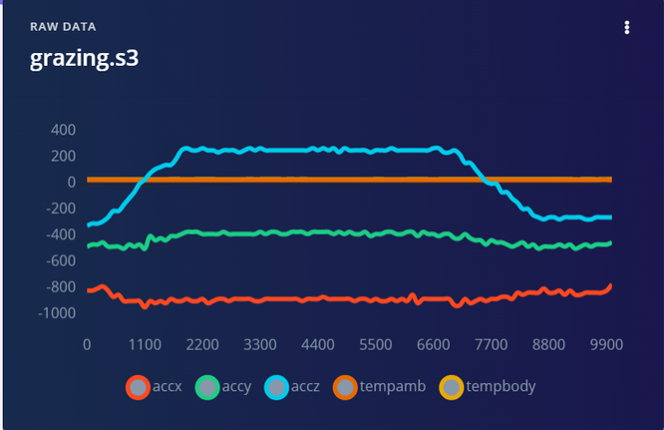
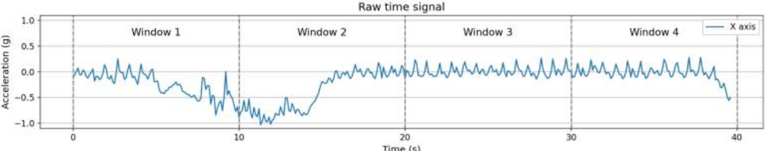
FINAL IMPLEMENTATION
Data Acquisition
We will utilize two distinct procedures to monitor and analyze animal behavior:
Tracking movement
Measuring body temperature
Data Preprocessing
The process involves dividing each time signal on each axis into consecutive time windows of 10 seconds each. This results in intervals containing 100 samples, with a sampling rate of 10 Hz providing 10 samples per second.
11 / 15

Slide 13
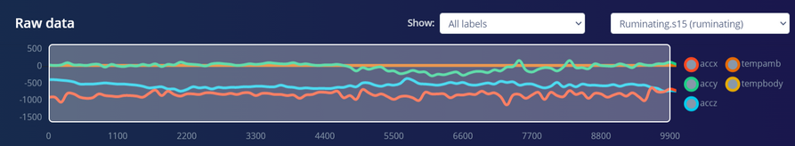
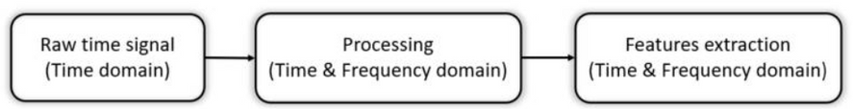
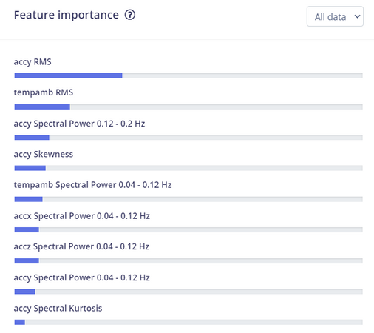
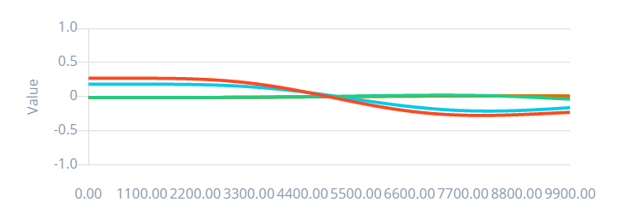
FINAL IMPLEMENTATION
Feature Engineering
The procedure for accelerometer raw data processing consists of different steps, these steps are shown in the figure below :
Before Filtering
After Filtering
Feature importance ranking
12 / 15

Slide 14
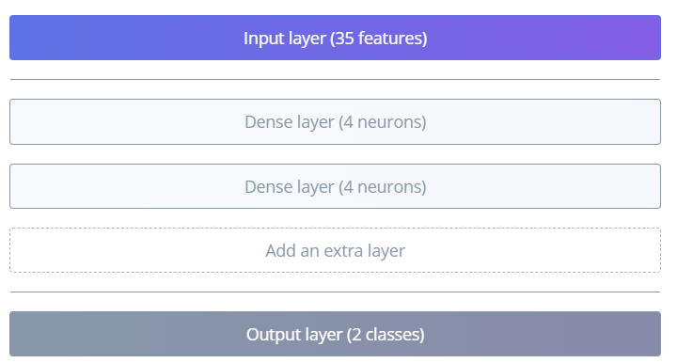
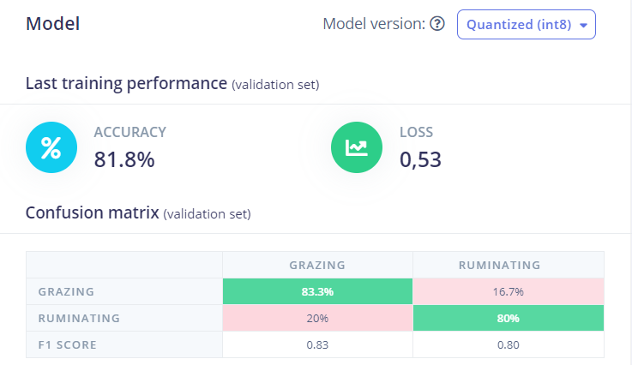
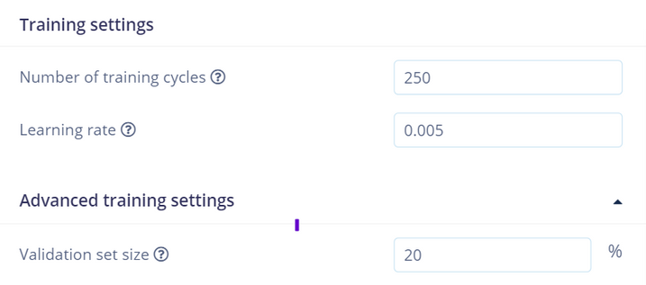
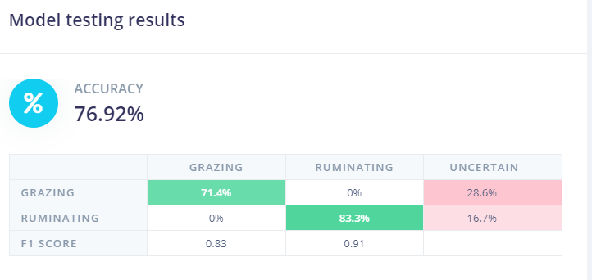
RESULTS
Neural Network Architecture
Model evaluation on Validation Set
Learning Hyperparameters
Model evaluation on Testing Set
13 / 15

Slide 15

S
M
A
Our tests validated the accuracy and reliability of our system. Although our Machine Learning model reached 80% accuracy due to a small dataset, our solution is ready for real-world implementation, enhancing estrus detection and cow health monitoring for improved productivity.
R
U
M
Y
14 / 15

Slide 16
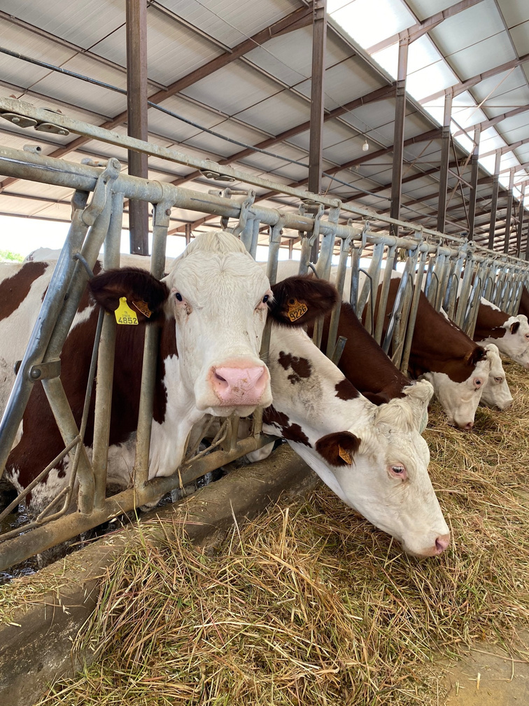
THANK YOU FOR
ATTENTION
15 / 15

